Slide 1

UNIT 2
By
Amandeep Kaur

Slide 2
Topics
Types of Schedulers
Scheduling Algorithms (Pre-emptive and Non-Preemptive..NP) & Criteria
Dispatcher
First Come First Serve (FCFS), Shortest Job First (SJF) under NP
Round Robin (RR), Priority Scheduling (PS), Multi Level Feedback Queue (MLFQ) under Pre-emptive
Multiprocessor Scheduling (MS)
Real Time Scheduling (RTS)
Thread Scheduling (TS)

Slide 3
Why Scheduling?
To maximize CPU utilization.
Context Switching
The aim of processor scheduling is to assign processes to be executed by the processor.
Scheduling affects the performance of the system, because it determines which process will wait and which will progress.
Degree of Multi-Programming: It tells us how many processes a single-processor system can handle well.

Slide 4
Scheduler and its types
The process of selecting processes among these queues (done by selector i.e. scheduler) is carried out by a dispatcher.
3 Types of (Scheduler & Queues):
Long-Term Scheduling or Job Scheduler. i.e. Ready Queue
Medium-Term Scheduling or Swapping Scheduler i.e. Waiting Queue
Short-Term Scheduling or CPU Scheduler. i.e. Running Queue

Slide 5
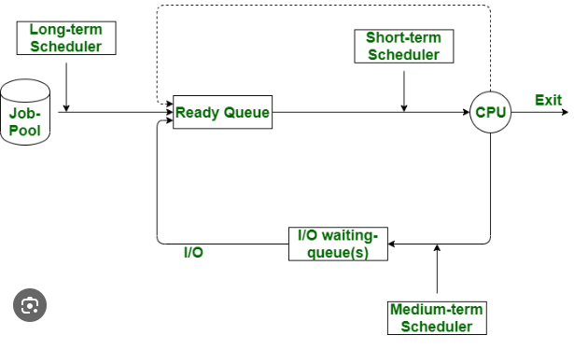
Types of Schedulers

Slide 6
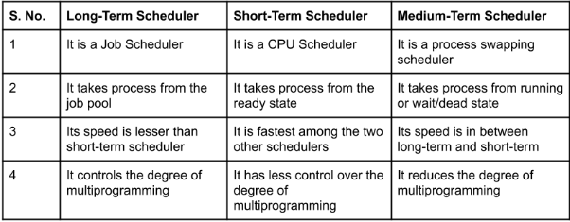
LTS,STS,MTS

Slide 7
Which of the following best describes the function of short-term scheduling (STS) in an operating system?
A) Selects which process should be brought into the ready queue from the job pool. B) Selects which process should be swapped out of the main memory to the secondary storage. C) Selects which process should be executed next by the CPU from the ready queue. D) Determines which process should be terminated to free up resources.

Slide 8
Ans: C
C) Selects which process should be executed next by the CPU from the ready queue.
Short-Term Scheduling (STS): Determines which process in the ready queue should be executed next by the CPU.
Long-Term Scheduling (LTS): Controls the admission of processes into the ready queue from the job pool.
Medium-Term Scheduling (MTS): Manages the swapping of processes in and out of main memory (related to the concept of swapping).

Slide 9
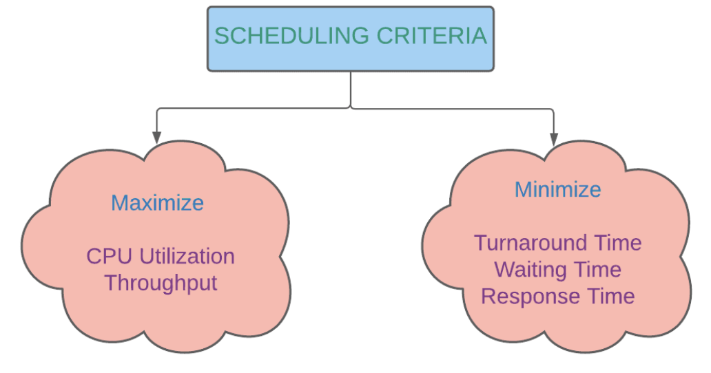
Why Scheduling Criteria ?

Slide 10
Scheduling criteria is also called as scheduling methodology. Key to multiprogramming is scheduling.
Different CPU scheduling algorithm have different properties .
The criteria used for comparing these algorithms include the following:
CPU Utilization: Keep the CPU as busy as possible. It range from 0 to 100%. In practice, it range from 40 to 90%.
Throughput: Throughput is the rate at which processes are completed per unit of time.
Scheduling Criteria

Slide 11
Scheduling Criteria
Arrival Time (AT): The time at which the process enter into RAM or Ready Queue.
Burst Time (BT): It refers to the time required by a process to get executed on a CPU. i.e. time duration
Completion Time (CT): The time at which the process get completed. i.e. (end time or completion time of process)
AT: Arrival Time
BT: Burst Time i.e. Run Time or Execution Time
CT: Completion Time
TAT: Turn Around Time (TAT=CT-AT)
WT: Waiting Time (WT=TAT-BT)
RT: Response Time (RT=ST-AT)
Avg. TAT= Sum(TAT)/n(P)
Avg. WT= Sum(WT)/n(P)

Slide 12
Which of the following scheduling criteria is concerned with the time a process takes from submission to completion?
A. CPU utilization B. Throughput C. Turn Around Time D. Waiting time

Slide 13
Ans. C
C. Turnaround time

Slide 14
Scheduling algorithms or scheduling policies are mainly used for short-term scheduling and the main objective of short-term scheduling is to allocate processor time in such a way as to optimize one or more aspects of system behavior.
For these scheduling algorithms assume only a single processor is present.
Scheduling algorithms decide which of the processes in the ready queue is to be allocated to the CPU is basis on the type of scheduling policy and whether that policy is either preemptive or non-preemptive. For scheduling arrival time and service time are also will play a role.
Scheduling Algorithms

Slide 15
NP(NON-PREMPTIVE)
FCFS (First-come First Served)
SJF (Shortest Job First )
PREEMPTIVE
SRTF (Shortest Remaining Time First)
PRIORITY
MIX
MULTIPROCESSOR
RT (Real Time )
MLFQ (Multilevel Feedback Queue)
THREAD
RR (Round-Robin)
Scheduling Algorithms

Slide 16
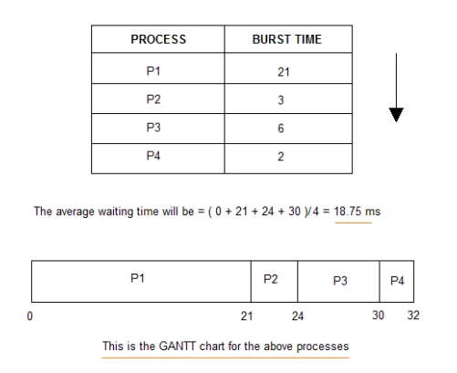
Gantt Chart (GC)
It is simply used for graphical representation of schedule .
A Gantt chart is a horizontal bar chart used to represent operating systems CPU scheduling in graphical view that help to plan, coordinate and track specific CPU utilization factor like throughput, waiting time, turnaround time etc.

Slide 17
First Come First Served Scheduling (FCFS)
FCFS:
The process which arrives first in the ready queue is firstly assigned the CPU.
In case of a tie, process with smaller process id is executed first.
It is always non-preemptive in nature.
Adv.
It is simple and easy to understand.
It can be easily implemented using queue data structure.
It does not lead to starvation.
Disadv.
Convey Effect:
Consider processes with higher burst time arrived before the processes with smaller burst time.
Then, smaller processes have to wait for a long time for longer processes to release the CPU.

Slide 18
Role PLAY (SRTF)

Slide 19
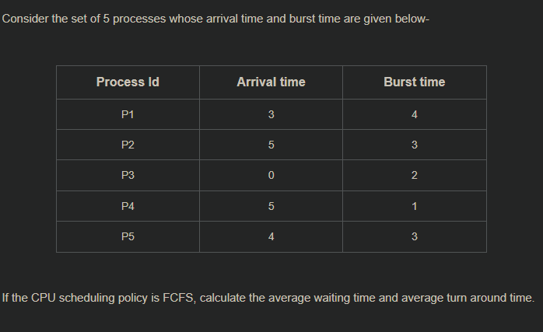
Exercise (FCFS)

Slide 20
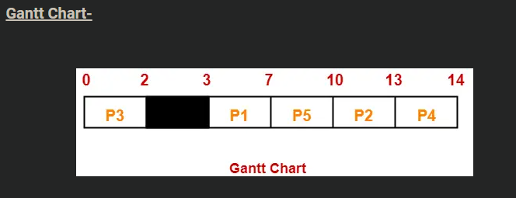
Ans. Avg. TAT=29/5 and Avg. WT=16/5

Slide 21
Shortest Job First(SJF)
SJF (NP)
SRTF(PRE-EMPTIVE)
Out of all the available processes, CPU is assigned to the process having smallest burst time.
In case of a tie, it is broken by FCFS Scheduling.
It is Non-Preemptive (NP) in nature.

Slide 22
Shortest Remaining Time First(SRTF)
SJF Scheduling can be used in both preemptive and non-preemptive mode.
Preemptive mode of Shortest Job First is called as Shortest Remaining Time First (SRTF).
Adv.
SRTF is optimal and guarantees the minimum average waiting time.
It provides a standard for other algorithms since no other algorithm performs better than it.
Disadv.
It can not be implemented practically since burst time of the processes can not be known in advance.
It leads to starvation for processes with larger burst time.
Priorities can not be set for the processes.
Processes with larger burst time have poor response time.

Slide 23
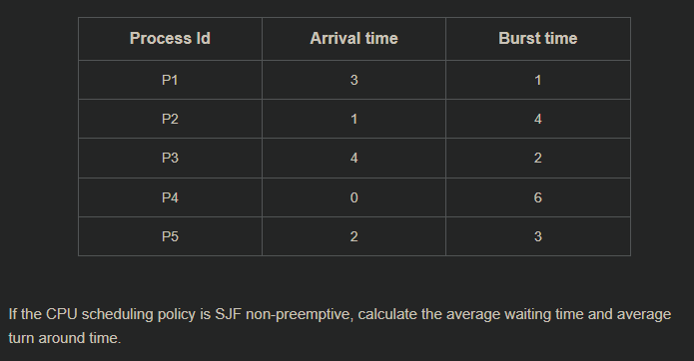
Example (SJF)

Slide 24
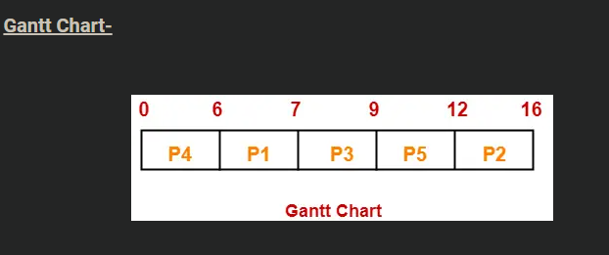
Ans. Avg. TAT=40 / 5 = 8 unit and Avg. WT= 24 / 5 = 4.8 unit

Slide 25
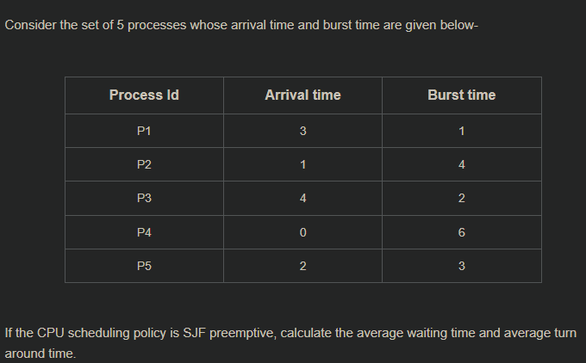
Example(SRTF)

Slide 27
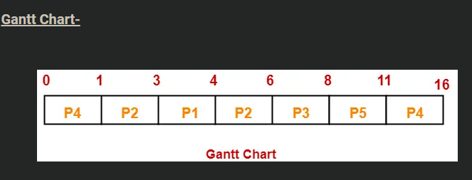
Ans. Avg. TAT=35 / 5 = 7 unit and Avg. WT= 19 / 5 = 3.8 unit

Slide 28
In the context of CPU scheduling, the shortest job first (SJF) algorithm is optimal in terms of:
A) Maximizing CPU utilization B) Minimizing average waiting time C) Minimizing turnaround time for long processes D) Maximizing throughput

Slide 29
Ans. B
B) Minimizing average waiting time

Slide 30
In the context of CPU scheduling, which of the following statements is true regarding the shortest remaining time first (SRTF) algorithm?
A) SRTF is a non-preemptive scheduling algorithm.
B) In SRTF, the process with the longest remaining time is given the CPU next.
C) SRTF is an optimal scheduling algorithm for minimizing average waiting time.
D) SRTF can lead to a convoy effect, where longer processes are delayed indefinitely.

Slide 31
Ans. C
C) SRTF is an optimal scheduling algorithm for minimizing average waiting time.

Slide 32
Priority Scheduling
Out of all the available processes, CPU is assigned to the process having the highest priority.
In case of a tie, it is broken by FCFS Scheduling.
Priority Scheduling can be used in both preemptive and non-preemptive mode.
By default, lower the number means higher the priority otherwise if mentioned in the question then follow the higher number means higher priority.
Adv:
It considers the priority of the processes and allows the important processes to run first.
Priority scheduling in preemptive mode is best suited for real time operating system.
Disadv.
Processes with lesser priority may starve for CPU.
There is no idea of response time and waiting time.

Slide 33
Note 1:
The waiting time for the process having the highest priority will always be zero in preemptive mode.
The waiting time for the process having the highest priority may not be zero in non-preemptive mode.
Note 2:
Priority scheduling in preemptive and non-preemptive mode behaves exactly same under following conditions-
The arrival time of all the processes is same
Important Notes-

Slide 34
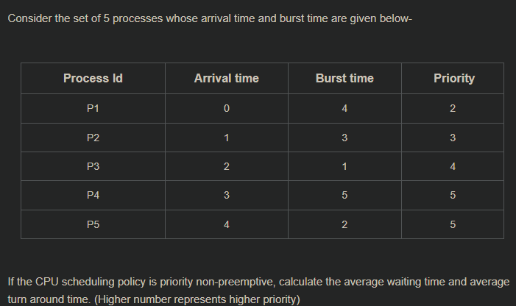
Example(PRIORITY)

Slide 35
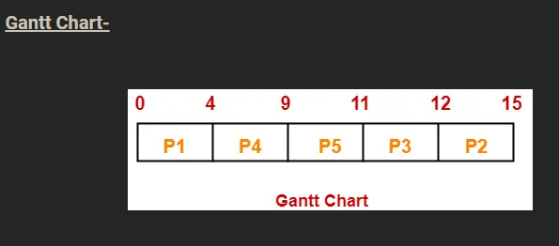
Ans. Avg. TAT= 41 / 5 = 8.2 unit and Avg. WT= 26 / 5 = 5.2 unit

Slide 36
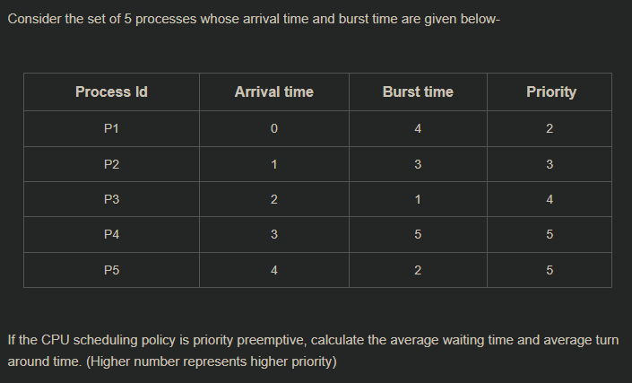
Example (priority)

Slide 37
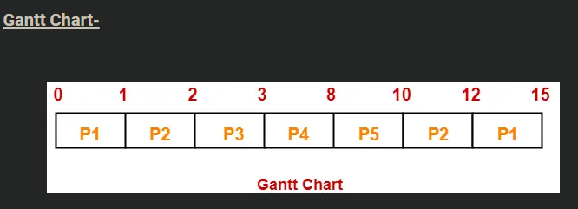
Ans. Avg. TAT= 38 / 5 = 7.6 unit and Avg. WT= 23 / 5 = 4.6 unit

Slide 38
Which of the following CPU scheduling algorithms can cause the phenomenon known as "starvation"?
A) First-Come, First-Served (FCFS) B) Shortest Job Next (SJN) C) Round Robin (RR) D) Priority Scheduling

Slide 39
Ans. D
D) Priority Scheduling
Priority Scheduling can lead to starvation, where lower-priority processes may never get executed if there are always higher-priority processes arriving.

Slide 40
Round-Robin (RR) Scheduling
Round Robin Scheduling is FCFS Scheduling with preemptive mode.
There are two Queues:
Ready Queue
Running Queue (Also called Gantt Chart)
It is always preemptive in nature.
CPU is assigned to the process on the basis of FCFS for a fixed amount of time.
This fixed amount of time is called as time quantum or time slice.
After the time quantum expires, the running process is preempted and sent to the ready queue.
Then, the processor is assigned to the next arrived process.
Adv.
It gives the best performance in terms of average response time.
It is best suited for time sharing system, client server architecture and interactive system.
Disadv.
It leads to starvation for processes with larger burst time as they have to repeat the cycle many times.
Its performance heavily depends on time quantum.
Priorities can not be set for the processes.

Slide 41
Important Notes (RR)
Note-01:
With decreasing value of time quantum,
number of context switch increases
Response time decreases
Chances of starvation decreases
Thus, smaller value of time quantum is better in terms of response time.
Note-02:
With increasing value of time quantum,
Number of context switch decreases
Response time increases
Chances of starvation increases
Thus, higher value of time quantum is better in terms of number of context switch.
Note-03:
With increasing value of time quantum, Round Robin Scheduling tends to become FCFS Scheduling.
When time quantum tends to infinity, Round Robin Scheduling becomes FCFS Scheduling.
Note-04:
The performance of Round Robin scheduling heavily depends on the value of time quantum.
The value of time quantum should be such that it is neither too big nor too small.

Slide 42
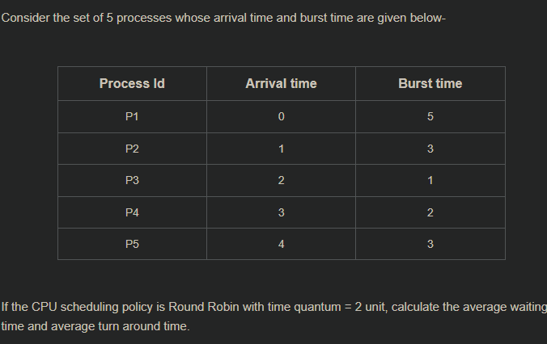
Example(RR)

Slide 43
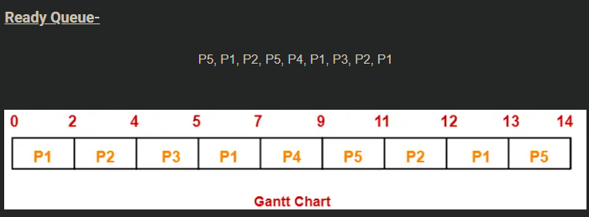
Ans. Avg. TAT=43 / 5 = 8.6 unit and Avg. WT= 29 / 5 = 5.8 unit

Slide 44
Ans. Avg. TAT=43 / 5 = 8.6 unit and Avg. WT= 29 / 5 = 5.8 unit

Slide 45
Ans. Avg. TAT=43 / 5 = 8.6 unit and Avg. WT= 29 / 5 = 5.8 unit

Slide 46
In the round robin scheduling algorithm, what primarily determines the time a process is allowed to run before it is swapped out?
a) Priority of the process b) Size of the process c) Time quantum d) CPU speed

Slide 47
Ans.C
c) Time quantum
Explanation: The Round Robin scheduling algorithm is time-sliced, where each process gets a fixed amount of CPU time called the time quantum. After the time quantum expires, the process is swapped out and moved to the back of the queue if it has not finished.

Slide 48
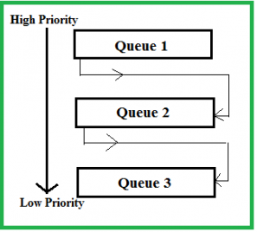
Multi-Level Feedback Queue (MLFQ)
A multilevel feedback queue (MLFQ) is a CPU scheduling algorithm that uses multiple queues with varying priorities to manage process execution.

Slide 49
In a multi-level feedback queue scheduling algorithm, how does a process move between the queues?
A) Based on the priority of the process. B) Based on the size of the process. C) Based on the CPU burst time of the process. D) Based on the I/O requirements of the process.

Slide 50
Ans.C
C) Based on the CPU burst time of the process.
Explanation: In a Multi-Level Feedback Queue, processes can move between queues based on their behavior and characteristics, like CPU burst time. If a process uses too much CPU time, it is moved to a lower-priority queue. If a process waits too long in a lower-priority queue, it may be moved to a higher-priority queue to prevent starvation.

Slide 51
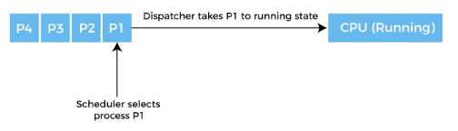
Dispatcher

Slide 52
Real Time Scheduling
Real time scheduling is of two types:
Soft Real-Time scheduling which does not guarantee when when a critical real-time process will be scheduled.(Algorithm: Rate Monotonic)
Hard Real-Time scheduling in which the process must be scheduled before the deadline.(Algorithm: Earliest Dead Line(EDL))
The foremost is that the processes are considered periodic i.e., the process will repeat itself after a fixed period of time. The period of a process is denoted by p. The next characteristic is the processing time t i.e., the time for which the process requires the CPU within each period. In other words processing time refers to the burst time. The final characteristic is the deadline d, i.e., the time before which the process must be serviced.

Slide 53
Types of RT Scheduling
In rate-monotonic scheduling algorithm a static priority policy with preemption is used. Whenever a high priority process arrives it will preempt a lower priority process. Every process gets the priority according to its period. Lower the period higher is the priority. Also, the processing time remains the same in each period.
In earlier deadline first scheduling algorithm assigns priority to the process based on the deadline. Earlier the deadline, higher is the priority. Thus, the priorities keep on changing in this scheduling.

Slide 54
Which of the following is NOT a characteristic of real-time scheduling algorithms in operating systems?
A) Predictability B) Deadline adherence C) Preemptive scheduling D) Round-robin fairness

Slide 55
Ans.D
D) Round-robin fairness
Explanation: Real-time scheduling focuses on predictability, deadline adherence, and preemptive scheduling to ensure critical tasks meet their deadlines. Round-robin fairness is not a priority in real-time systems, as it might not guarantee that high-priority or time-sensitive tasks are completed on time.

Slide 56
In multi-processor system, there are multiple CPUs.
Load Balancing: The load is distributed among these available processors.
But in multi-processor system, it is quite complex.
Types:
Asymmetric Multiprocessing: All scheduling decisions, I/O processing, and other system activities handled by a single processor- master server.
Local Ready Queue
Symmetric Multiprocessing (SMP): Each processor is self-scheduling. All processes may be in a common ready queue, or each processor may have its own private queue of ready processes.
Global Ready Queue
Multi-Processor Scheduling

Slide 57
Avoid migration of processes from one processor to another and instead attempt to keep a process running on the same processor. This is known as processor affinity.
i.e. a process has an affinity for the processor on which it is currently running.
Types:
Soft affinity: It is possible for a process to migrate between processors.(migration possible)
Hard affinity: Allowing a process to specify that it is not to migrate to other processors. .(migration strictly not possible)
Process Affinity and its types

Slide 58
A thread is the smallest unit of execution which has its own thread ID, program counter, register set and stack. All the threads that belong to the same process share the code, data section and other resources like open files belonging to the process. So, remember thread is a part of the process. A thread can not exist without a process.
Types:
User threads are supported above the kernel and managed without kernel support whereas Kernel threads are supported and managed directly by OS.
Thread Scheduling

Slide 59
References
OPERATING SYSTEM CONCEPTS by ABRAHAM SILBERSCHATZ, PETER B. GALVIN, GERG GAGNE, WILEY
DESIGN OF THE UNIX OPERATING SYSTEM by MAURICE J. BACH, Pearson Education India
REAL-TIME SYSTEMS by JANE W. S. LIU, Pearson Education India
https://www.javatpoint.com/os-scheduling-algorithms
https://www.idconline.com/technical_references/pdfs/information_technology/Types_of_Scheduling.pdf

Slide 60
References
https://www.gatevidyalay.com/first-come-first-serve-cpu-scheduling/
https://www.gatevidyalay.com/sjf-scheduling-srtf-cpu-scheduling/
https://www.gatevidyalay.com/round-robin-round-robin-scheduling-examples/
https://www.javatpoint.com/os-fcfs-scheduling

Slide 61
Thank You

